Slide 1
Incident and Disaster Response
Corporate Computer Security, 4th Edition
Randall J. Boyle & Raymond R. Panko
Chapter 10

Slide 2
Orientation
In previous chapters, we looked at threats, planning, and protections
In Chapter 10, we complete the discussion of the plan-protect-respond cycle
Response planning is necessary because defenses can never stop all attacks. Companies must respond appropriately when attacks happen or natural disasters occur.

Slide 3
10.1: Incident Response
Incidents Happen
Protections inevitably break down, occasionally
Successful attacks are called security incidents, breaches, or compromises
Incident Severity
False alarms
Apparent compromises are not real compromises
Also called false positives
Handled by the on-duty staff
Wastes time and may dull vigilance

Slide 4
10.1: Incident Response
Incident Severity
Major incidents
Beyond the capabilities of the on-duty staff
Must bring together a Computer Security Incident Response Team (CSIRT)
CSIRT needs participation beyond IT security

Slide 5
10.1: Incident Response
Incident Severity
Disasters
Fires, floods, hurricanes, major terrorist attacks
Must assure business continuity
Maintaining the day-to-day operations of the firm
Requires a business continuity group headed by a senior manager
Core permanent staff will facilitate activities
IT disaster response is restoring IT services
May be a subset of business continuity
May be a stand-alone IT disaster

Slide 6
10.1: Rehearsals for Speed and Accuracy
Speed and Accuracy Are Essential
Speed of response can reduce damage
Attacker will have less time to do damage
The attacker cannot burrow as deeply into the system that become very difficult to detect
Speed is also necessary in recovery

Slide 7
10.1: Rehearsals for Speed and Accuracy
Speed and Accuracy Are Essential
Accuracy is equally important
Common mistake is to act on incorrect assumptions
If problem is misdiagnosed or the wrong approach is taken, can make things much worse
Take your time quickly

Slide 8
10.1: Rehearsals for Speed and Accuracy
Planning Before an Incident or Disaster
Incident response is reacting to incidents according to plan
Decide what to do ahead of time
Time to consider matters thoroughly and without the time pressure of a crisis
During an attack, human decision-making skills degrade
Must have flexibility within the plan to adapt
Best to adapt within a plan than to improvise completely

Slide 9
10.1: Rehearsals for Speed and Accuracy
Team Members Must Rehearse the Plan
Rehearsals find mistakes in the plan
Practice builds speed
Types of Rehearsals
Walkthroughs (table-top exercises)
Live tests (actually doing planned actions) can find subtle problems, but are expensive

Slide 10
10.2: The Incident Response Process: Part I
Process for Major Incidents
Detection, Analysis, and Escalation
Detection: Must detect through technology or people
Need good intrusion detection technology
All employees must know how to report incidents
Analysis: Must analyze the incident enough to guide subsequent actions
Confirm that the incident is real
Determine its scope: Who is attacking; what are they doing; how sophisticated they are, etc.

Slide 11
10.2: The Incident Response Process: Part I
Detection, Analysis, and Escalation
Escalation: If deemed severe enough, escalate to a major incident
Pass to the CSIRT, the disaster response team, or the business continuity team

Slide 12
10.2: The Incident Response Process: Part I
Containment
Disconnection of the system from the site network or the site network from the Internet (damaging)
Harmful, so must be done only with proper authorization
This is a business decision, not a technical decision

Slide 13
10.2: The Incident Response Process: Part I
Containment
Continue to collect data to understand the situation (allows harm to continue)
Especially necessary if prosecution is desired

Slide 14
10.2: The Incident Response Process: Part I
Recovery
Repair during continuing server operation
Avoids lack of availability
No loss of data
Possibility of a rootkit not having been removed, etc.

Slide 15
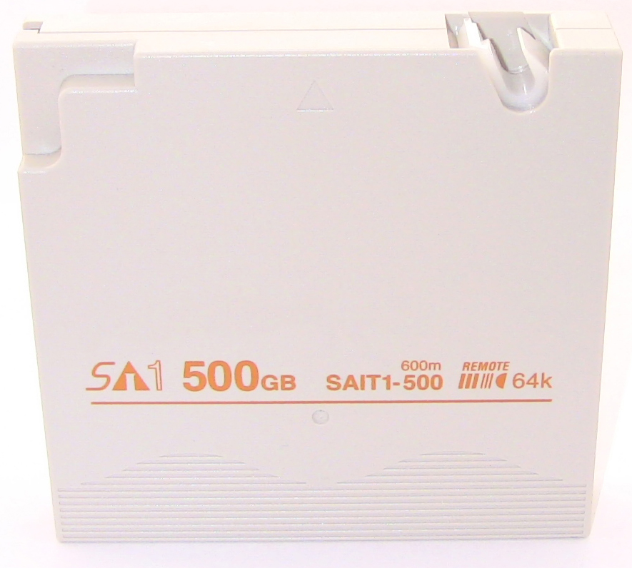
10.2: The Incident Response Process: Part I
Recovery
Data
Restoration from backup tapes
Loses data since last trusted backup

Slide 16
10.2: The Incident Response Process: Part I
Recovery
Software
Total software reinstallation of operating system and applications may be necessary for the system to be trusted
Manual reinstallation of software
Need installation media and product activation keys
Must have good configuration documentation before the incident
Reinstallation from a disk image
Can greatly reduce time and effort
Requires a recent disk image

Slide 17
10.2: The Incident Response Process: Part II
Punishment
Punishing employees is usually fairly easy
Most employees are at-will employees
Companies usually have wide discretion in firing at-will employees
This varies internationally
Union agreements may limit sanctions or at least require more detailed processes
Notes:
At-will employment is a term used in U.S. labor law for contractual relationships in which an employee can be dismissed by an employer for any reason (that is, without having to establish "just cause" for termination), and without warning, as long as the reason is not illegal (e.g. firing because of the employee's race…

Slide 18
10.2: The Incident Response Process: Part II
Punishment
The decision to pursue criminal prosecution
Must consider cost and effort
Must consider probable success if pursued (attackers are often minors or foreign nationals)
Loss of reputation because the incident becomes public

Slide 19
10.2: The Incident Response Process: Part II
Punishment
Collecting and managing evidence
Forensics: Courts have strict rules for admitting evidence in court
Call the authorities and a forensics expert for help

Slide 20
10.2: The Incident Response Process: Part II
Punishment
Collecting and managing evidence
Protecting evidence
Pull the plug on a server if possible
This is a business decision, not an IT decision
Document the chain of custody
Who held the evidence at all times
What they did to protect it
Document the chain of custody

Slide 21
10.2: The Incident Response Process: Part II
Post-mortem Evaluation
What should we do differently next time?

Slide 22
10.3: Intrusion Detection Systems (IDSs)
Event logging for suspicious events
Sometimes send alarms
A detective control, not a preventative or restorative control

Slide 23
10.3: Managing IDSs
Updates
Program, attack signatures must be updated frequently
Processing Performance
If processing speed cannot keep up with network traffic, some packets will not be examined
This can make some IDSs useless during attacks that increase the traffic load

Slide 24
10.3: Managing IDSs
Storage
Limited disk storage for log files
When log files reach storage limits, they must be archived
Event correlation is difficult across multiple backup tapes
Adding more disk capacity reduces the problem but never eliminates it

Slide 25
10.3: Honeypots
Honeypot
A fake server or entire network segment with multiple clients and servers
Legitimate users should never try to reach resources on the honeypot
Primarily used by researchers studying attacker behavior by recording everything a visitor does

Slide 26
10.4: Business Continuity Planning
Business Continuity Planning
A business continuity plan specifies how a company plans to restore or maintain core business operations when disasters occur
Disaster response is restoring IT services

Slide 27
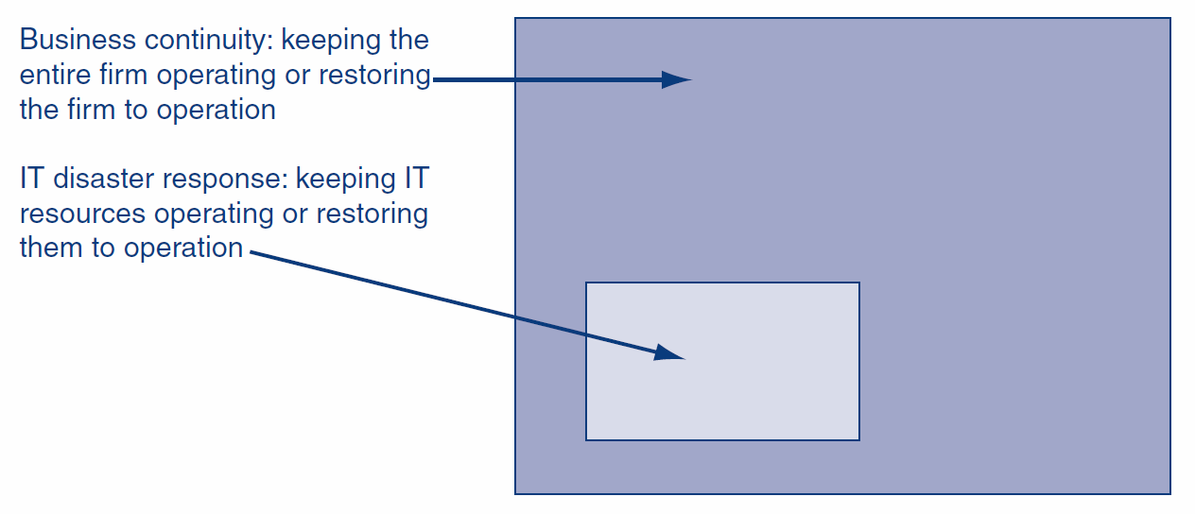
10.4: Business Continuity Planning

Slide 28
10.4: Business Continuity Planning
Principles of Business Continuity Management
Protect people first

Slide 29
10.4: Business Continuity Planning
Principles of Business Continuity Management
Avoid rigidity
Unexpected situations will arise
Communication will break down and information will be unreliable
Decision makers must have the flexibility to act

Slide 30
10.4: Business Continuity Planning
Principles of Business Continuity Management
Communication
Try to compensate for inevitable breakdowns
Have a backup communication system
Communicate constantly to keep everybody “in the loop”

Slide 31
10.4: Business Continuity Planning
Business Process Analysis
Identification of business processes and their interrelationships
Prioritization of business processes
Downtime tolerance (in the extreme, mean time to belly-up)
Importance to the firm
Required by higher-importance processes
Resource needs (must be shifted during crises)
Cannot restore all business processes immediately

Slide 32
10.4: Business Continuity Planning
Updating the Plan
Must be updated frequently
Business conditions change and businesses reorganize constantly
People who must execute the plan also change jobs constantly
Telephone numbers and other contact information must be updated far more frequently than the plan as a whole
Should have a small, permanent staff

Slide 33
10.5: IT Disaster Recovery
IT Disaster Recovery
Looks specifically at the technical aspects of how a company can get its IT back into operation using backup facilities
A subset of business continuity or for disasters that only affect IT
All decisions are business decisions and should not be made by IT or IT security staff

Slide 34
10.5: IT Disaster Recovery
Types of Backup Facilities
Hot sites
Ready to run (e.g., power, HVAC, computers) - just add data
Considerations: Rapid readiness at high cost
Must be careful to have the software at the hot site up-to-date in terms of configuration
Notes:
A hot site is a backup facility which represents a mirrored copy of the primary production center. A hot site is equipped with all the necessary hardware, software, and network connectivity, which allows you to perform near real-time backup or replication of the critical data.

Slide 35
10.5: IT Disaster Recovery
Types of Backup Facilities
Cold sites
Building facilities, power, HVAC, communication to outside world only
No computer equipment
Less expensive but usually take too long to get operating
Notes:
A cold site is the least expensive type of backup site for an organization to operate. It does not include backed up copies of data and information from the original location of the organization, nor does it include hardware already set up.

Slide 36
10.5: IT Disaster Recovery
Types of Backup Facilities
Site sharing
Site sharing among a firm’s sites (problem of equipment compatibility and data synchronization)
Continuous data protection needed to allow rapid recovery
Notes:
Backup sites can come from three different sources: Companies specializing in providing disaster recovery services. Other locations owned and operated by your organization. A mutual agreement with another organization to share data center facilities in the event of a disaster.

Slide 37
10.5: IT Disaster Recovery
Office Computers
Hold much of a corporation’s data and analysis capability
Will need new computers if old computers are destroyed or unavailable
Will need new software
Well-synchronized data backup is critical
People will need a place to work

Slide 38
10.5: IT Disaster Recovery
Restoration of Data and Programs
Restoration from backup tapes; need backup tapes at the remote recovery site
May be impossible during a disaster
Testing the IT Disaster Recovery Plan
Difficult and expensive
Necessary

